Slide 1
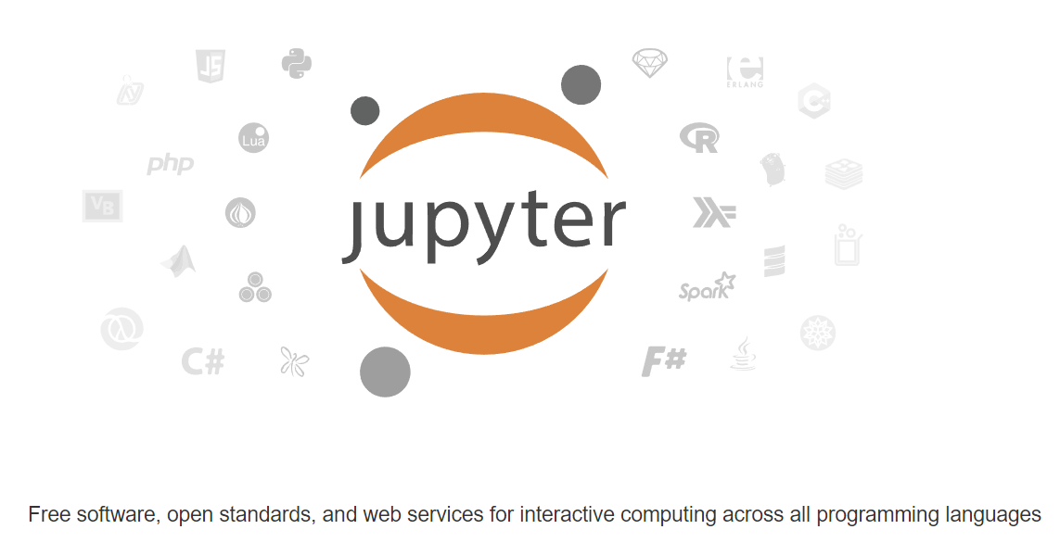

Introduction to jupyter notebooks Part 1

Slide 2
What you will learn
Introduction
Setting Up JupyterLab
Basic Features of JupyterLab
Adding Visuals and Interactivity
Sharing and Exporting Notebooks
Best Practices and Tips
Conclusion

Slide 3
introduction

Slide 4
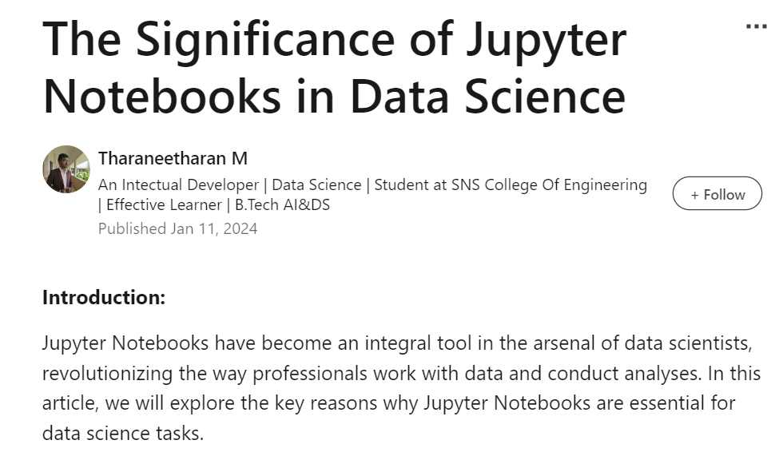
Notes:
https://www.linkedin.com/pulse/significance-jupyter-notebooks-data-science-tharaneetharan-m-kclfc

Slide 5
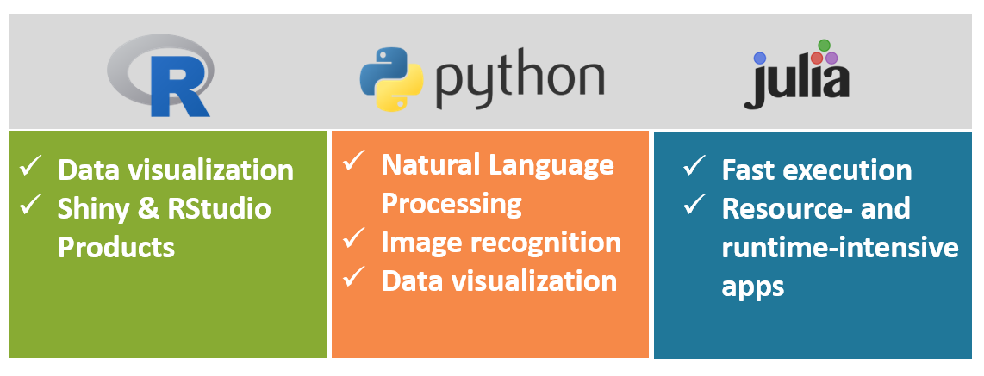
What does “Jupyter” mean?
Ju(lia)pyt(hon)er

Slide 6
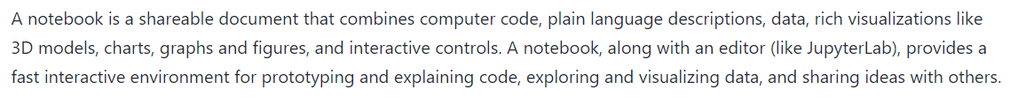
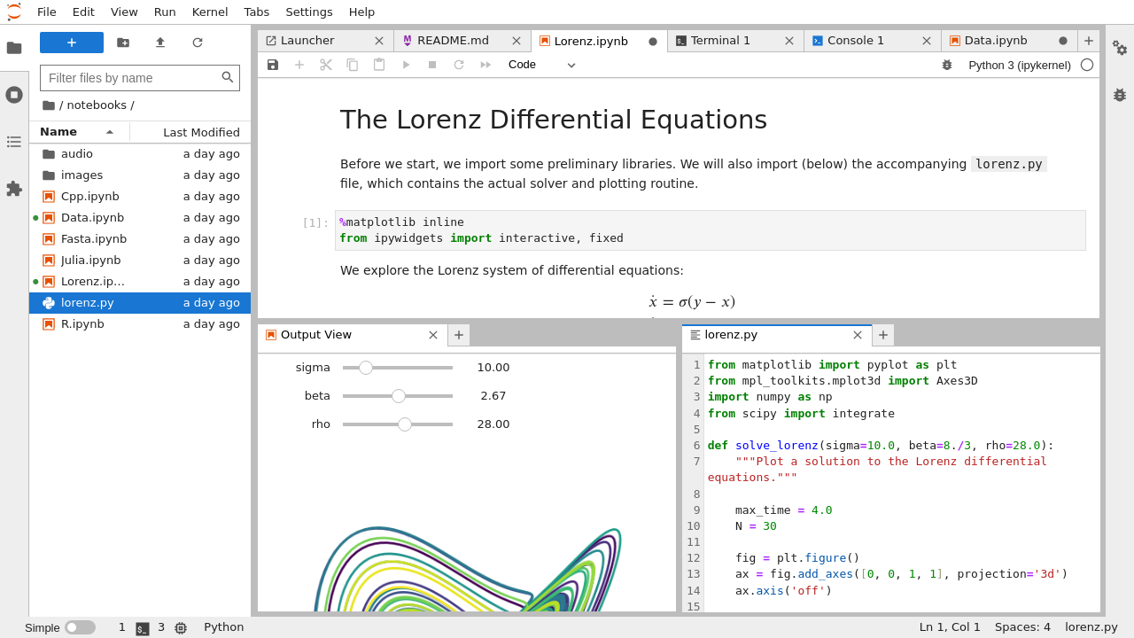
What is a notebook?
Notes:
https://docs.jupyter.org/en/latest/

Slide 7
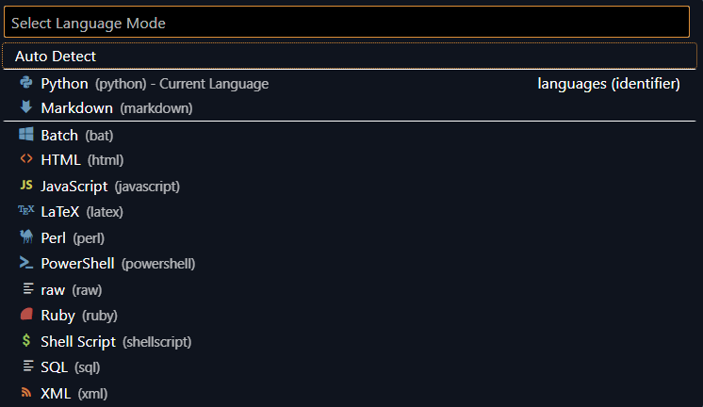
It’s not just for three languages…

Slide 8
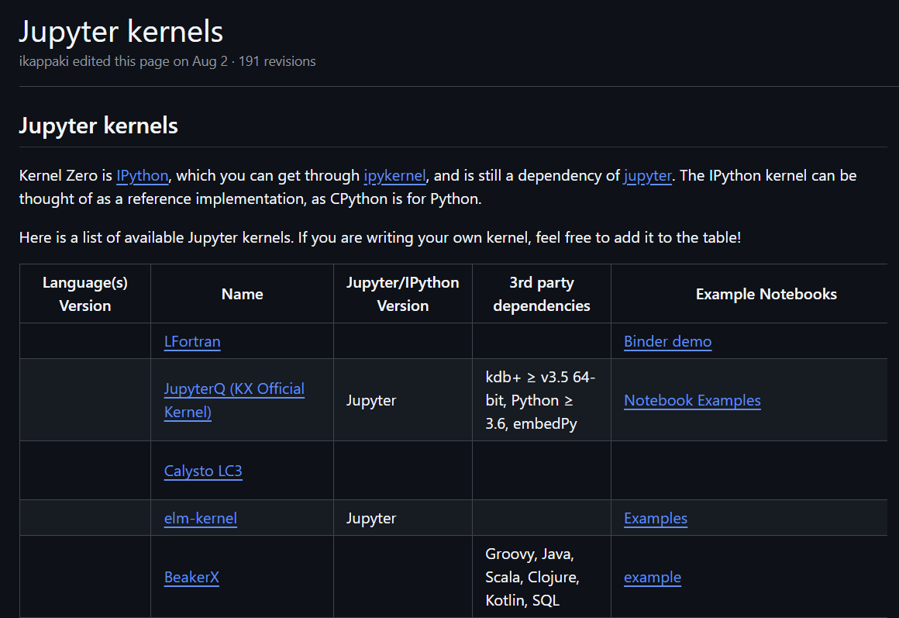
Even more languages!?!
Notes:
https://github.com/jupyter/jupyter/wiki/Jupyter-kernels

Slide 9
Setting up JupyterLab

Slide 10
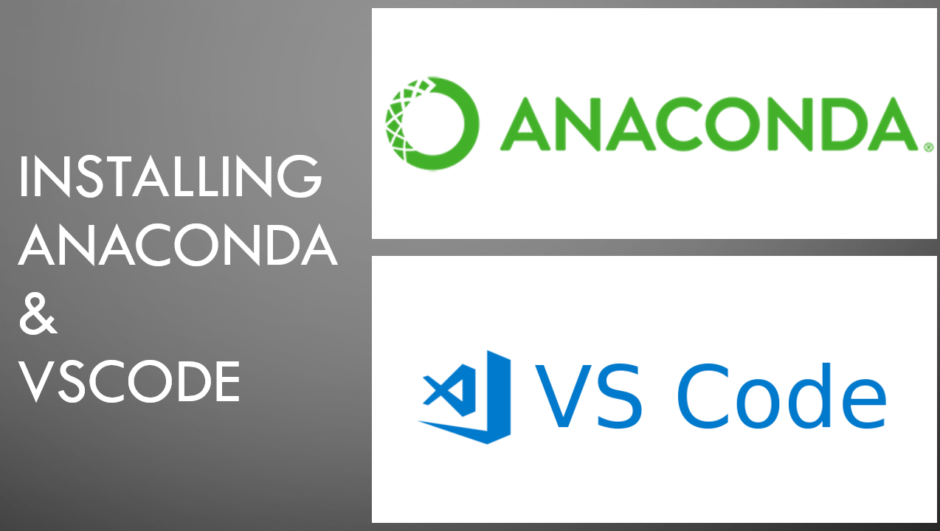
Notes:
https://www.youtube.com/watch?v=50TM9pfYv5U&list=PL7hc7ZLdMi6rbt-x9pjg4PByKFZz3hx7Q

Slide 11
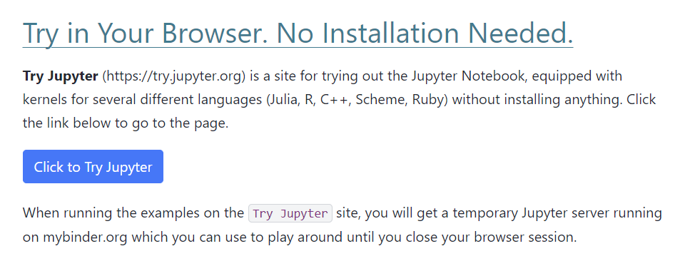
Notes:
https://jupyter.org/try

Slide 12
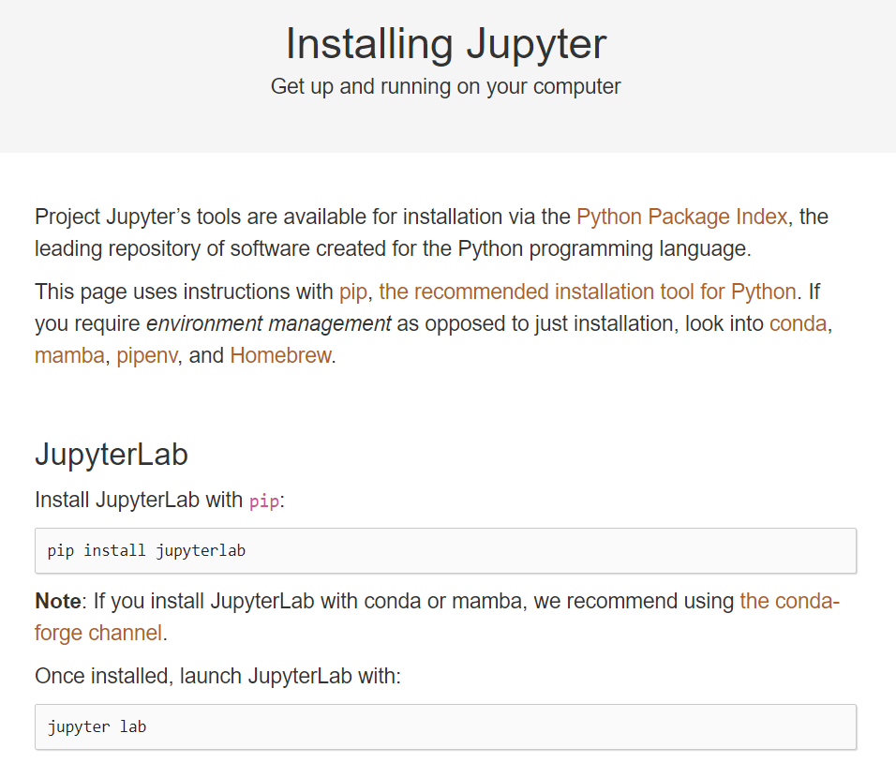

Slide 13
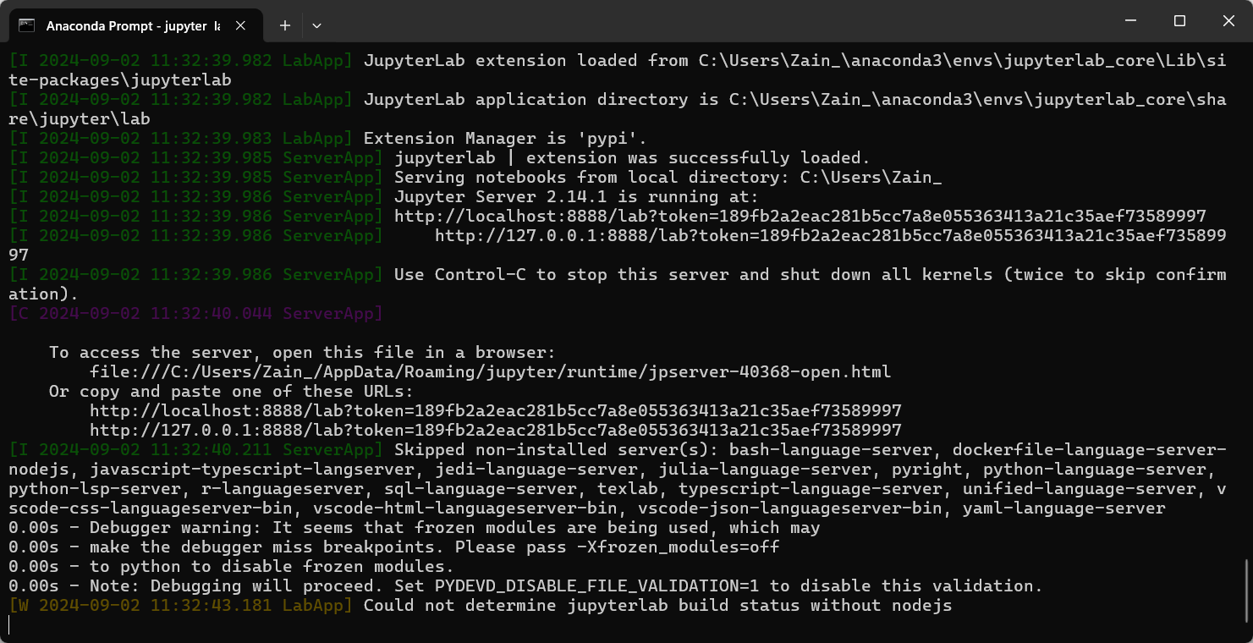

Slide 14
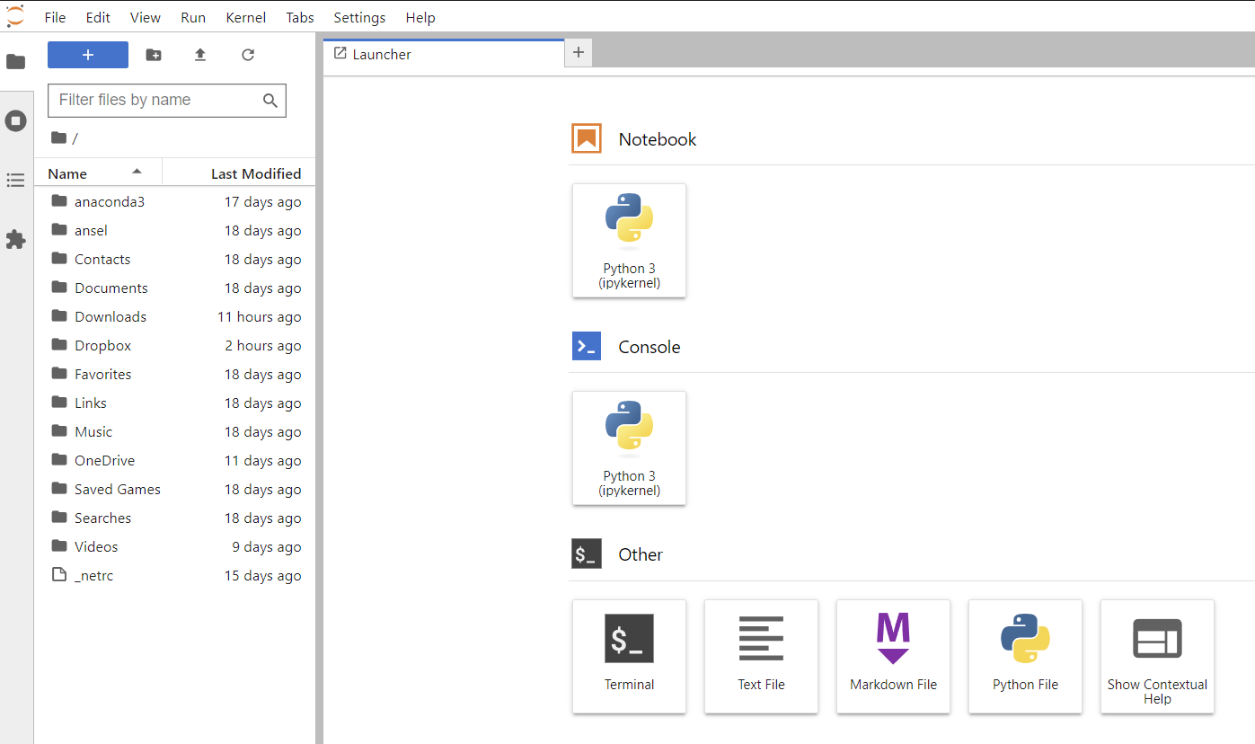

Slide 15
setting up JupyterLab in conda
conda create -n jupyterlab_core python numpy pandas matplotlib jupyterlab
conda activate jupyterlab_core
jupyter lab

Slide 16
Basic Features of Jupyterlab

Slide 17
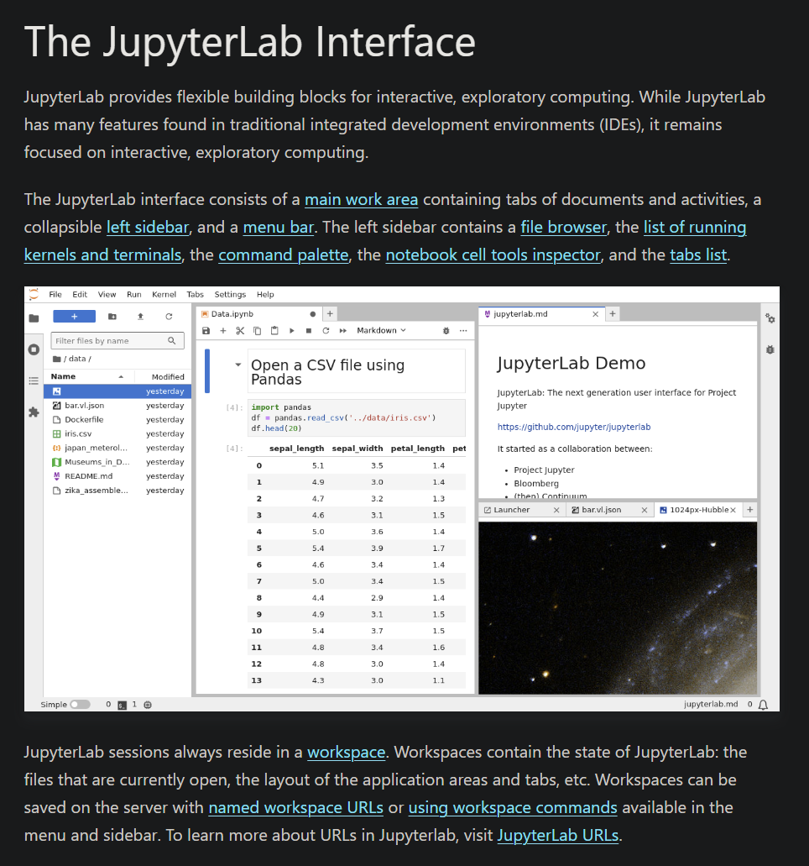
Notes:
https://jupyterlab.readthedocs.io/en/stable/user/interface.html

Slide 18
Launcher

Slide 19
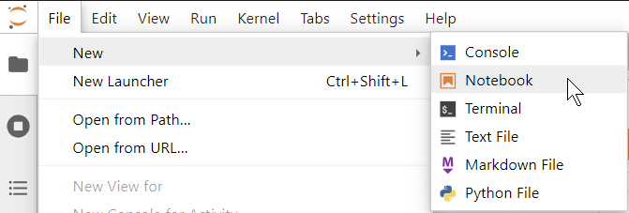
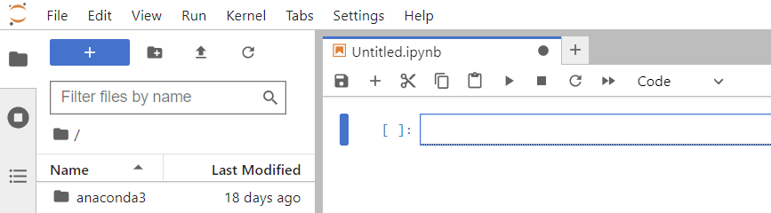
Creating a new notebook

Slide 20


